Slide 1
Diversity in Luxury

Slide 2
Diversity in Luxury

Slide 3
Concept
EAGLE PINE
GOLF INTEGRATED
RESIDENTIAL LUXURY RESORT
WITH HOTEL & SPA
The EAGLE PINE GOLF RESORT embodies a flawless fusion of leisure and world-class golfing. Designed by a dynamic team, the resort is aimed at offering a true feeling of mystery, excitement, and remoteness from everyday life.

Slide 4
Concept
Eagle Pine Resort
GOLF INTEGRATED
RESIDENTIAL LUXURY RESORT
WITH HOTEL & SPA
The EAGLE PINE GOLF RESORT embodies a flawless fusion of leisure and world-class golfing. Designed by a dynamic team, the resort is aimed at offering a true feeling of mystery, excitement, and remoteness from everyday life.

Slide 5
Overview
Concept
GOLF INTEGRATED
RESIDENTIAL LUXURY RESORT
WITH HOTEL & SPA
Located north-west of the thriving, cosmopolitan city of Limassol, the EAGLE PINE golf course will feature an undulating, windswept terrain and dune-style landscape spearheaded by Graham Marsh and the resort’s owner, Aristo Developers, allowing golfers to immerse themselves in the five-star EAGLE PINE experience.

Slide 6
Overview
CONCEPT
Total land to be constructed 1,717,521 m²
Actual buildable area 205,000 m²
The land is encumbrance/mortgage free, and is solely owned by the Aristo Developers Ltd Group of Companies
INVESTMENT HIGHLIGHTS

Slide 7
80
1000
Deluxe Rooms
Residences
FIVE-STAR
BOUTIQUE HOTEL
700 VILLAS IN INDIVIDUAL PLOTS
300 VILLAS, T/HOUSES, APTS IN UNIFIED DEVELOPMENTS
Eagle Pine Golf Resort comprises an 18-hole golf course, an 80 deluxe sea-view rooms boutique hotel, a commercial area and a large residential development over 676 individual plots for 700 villas and 5 clusters of land for 300 villas / townhouses / apartments.
Hotel and Residences

Slide 8
80
1000
Deluxe Rooms
Residences
FIVE-STAR
BOUTIQUE HOTEL
700 VILLAS IN INDIVIDUAL PLOTS
300 VILLAS, T/HOUSES, APTS IN UNIFIED DEVELOPMENTS
Eagle Pine Golf Resort comprises an 18-hole golf course, an 80 deluxe sea-view rooms boutique hotel, a commercial area and a large residential development over 676 individual plots for 700 villas and 5 clusters of land for 300 villas / townhouses / apartments.
Hotel and Residences

Slide 9
2,145m²
Retail Area
FOR A UNIQUE
SHOPPING EXPERIENCE
The total land on which the project will be constructed is 1.717.521 m², whereas the total covered area per official policy utilised is 150.000m² (actual buildable area expected to exceed 204.948m²). The land belongs to the Aristo Developers Ltd Group of Companies on a wholly owned subsidiary and is free of any mortgage or encumbrance.
Retail

Slide 10
2,145m²
Retail Area
FOR A UNIQUE
SHOPPING EXPERIENCE
The total land on which the project will be constructed is 1.717.521 m², whereas the total covered area per official policy utilised is 150.000m² (actual buildable area expected to exceed 204.948m²). The land belongs to the Aristo Developers Ltd Group of Companies on a wholly owned subsidiary and is free of any mortgage or encumbrance.
Retail

Slide 11
18-hole
Golf Course
CHAMPIONSHIP GOLF COURSE
DESIGNED BY GRAHAM MARSH AND GOLF & LAND DESIGN
The total land on which the project will be constructed is 1.717.521 m², whereas the total covered area per official policy utilised is 150.000m² (actual buildable area expected to exceed 204.948m²). The land belongs to the Aristo Developers Ltd Group of Companies on a wholly owned subsidiary and is free of any mortgage or encumbrance.
Golf

Slide 12
18-hole
Golf Course
CHAMPIONSHIP GOLF COURSE
DESIGNED BY GRAHAM MARSH AND GOLF & LAND DESIGN
The total land on which the project will be constructed is 1.717.521 m², whereas the total covered area per official policy utilised is 150.000m² (actual buildable area expected to exceed 204.948m²). The land belongs to the Aristo Developers Ltd Group of Companies on a wholly owned subsidiary and is free of any mortgage or encumbrance.
Golf

Slide 13
INVESTMENT HIGHLIGHTS
Invest in an exciting and exclusive new Golf Resort Project with promising returns.
Project’s Pre-Money Valuation: €60 million
VAT: No VAT applies in acquiring shares.
Debt Free: Eagle Pine Golf Resort Ltd is free of any mortgages / encumbrances on the project land
Investor’s Metrics: An investment of €50 million in a new issue of ordinary shares, will grant the investor 45.45% in the project company Eagle Pine Golf Resort Ltd.
Return on Investment (ROI) : 250%
IRR : > 15%
Payback Period : 6 years
INDEX

Slide 14
Overview
80
1000
2,145m²
18-hole
Deluxe Rooms
Residences
Retail Area
Golf Course
FIVE-STAR
BOUTIQUE HOTEL
700 VILLAS IN INDIVIDUAL PLOTS
300 VILLAS, T/HOUSES, APTS IN UNIFIED DEVELOPMENTS
FOR A UNIQUE
SHOPPING EXPERIENCE
CHAMPIONSHIP GOLF COURSE
DESIGNED BY GRAHAM MARSH AND GOLF & LAND DESIGN
Eagle Pine Golf Resort comprises an 18-hole golf course, an 80 deluxe sea-view rooms boutique hotel, a commercial area and a large residential development over 676 individual plots for 700 villas and 5 clusters of land for 300 villas / townhouses / apartments.
The total land on which the project will be constructed is 1.717.521 m², whereas the total covered area per official policy utilised is 150.000m² (actual buildable area expected to exceed 204.948m²). The land belongs to the Aristo Developers Ltd Group of Companies on a wholly owned subsidiary and is free of any mortgage or encumbrance.
The permit for the golf course, the club house, the road network and the land division into building plots and common development areas has been issued and we have prepared for submission the town planning applications for the hotel and the commercial facility. Permits for residential developments will be taken in phases. The project is therefore ready to go into construction. text

Slide 15
Location
EAGLE PINE
GOLF INTEGRATED
RESIDENTIAL LUXURY RESORT
WITH HOTEL & SPA
The EAGLE PINE GOLF RESORT embodies a flawless fusion of leisure and world-class golfing. Designed by a dynamic team, the resort is aimed at offering a true feeling of mystery, excitement, and remoteness from everyday life.

Slide 16
Cyprus
THE JEWEL OF
THE MEDITERRANEAN
The island of Cyprus is multi-layered like its history, with a compelling lifestyle and landscape overseen by warm and hospitable people; a magnet for international travellers and discerning buyers seeking a home in the sun.

Slide 17
CYPRUS
CYPRUS
RUSSIA
EUROPE
ASIA
Mediterranean sea
MIDDLE EAST
AFRICA
Strategic location crossroads of three continents (Africa, Asia and Europe)
European Member State
5th Best Relocation Destination Globally (Knight Frank)
Safest European Country (Value Penguin)
Advanced and Modern Infrastructure

Slide 18
CYPRUS
RUSSIA
ASIA
MIDDLE EAST
AFRICA
Lowest corporate tax regime in the EU (12,5%)
Cosmopolitan lifestyle Cultural diversity Excellent infrastructure
Modern healthcare facilities and centres
Pleasant Mediterranean climate
Rich in culture and history
English widely spoken
Blue flag awarded beaches
Picturesque villages and mountains with pine forests Winter ski resorts

Slide 19
CYPRUS
RUSSIA
ASIA
MIDDLE EAST
AFRICA
Lowest corporate tax regime in the EU (12,5%)
Cosmopolitan lifestyle Cultural diversity Excellent infrastructure
Modern healthcare facilities and centres
Pleasant Mediterranean climate
Rich in culture and history
English widely spoken
Blue flag awarded beaches
Picturesque villages and mountains with pine forests Winter ski resorts

Slide 20
CYPRUS
Known as the commercial, shipping and business heartland of Cyprus, Limassol is one of the most important tourism, trade, and service-providing centres in the eastern Mediterranean
Cosmopolitan lifestyle
4th Best Retirement Destination Globally (Knight Frank)
Business, shipping and commercial heartland
Tourism, trade and service-providing centre

Slide 21
Limassol
FOR ALL SEASONS
AND REAONS
The most important tourism, trade and service- providing centre in the
eastern Mediterranean
Cosmopolitan lifestyle with popular year-round festivals 340 days of sunshine
Rich in culture and history English widely spoken
Safe and friendly environment
Five star hotels and resorts, vibrant nightlife, entertainment and outdoor excursions
Wide range of shopping centres with international brands
Public and private educational institutions
Excellent healthcare facilities
Short dive to countrysides, vineyards, traditional villages and ski resorts

Slide 22
Collaborators
EAGLE PINE
GOLF INTEGRATED
RESIDENTIAL LUXURY RESORT
WITH HOTEL & SPA
The EAGLE PINE GOLF RESORT embodies a flawless fusion of leisure and world-class golfing. Designed by a dynamic team, the resort is aimed at offering a true feeling of mystery, excitement, and remoteness from everyday life.

Slide 23
Collaborators
The Team
AN INTERNATIONAL ASSEMBLY OF ESTEEMED ARCHITECTS AND CONSULTANTS HAVE COOPERATED IN CARRYING OUT THE PROJECT.
The EAGLE PINE GOLF RESORT is designed to become a centre piece for golfing excellence. Our vision is to create an architecturally striking resort, incorporating golf, boutique hotel and spa, retail and opulent residences – to build a diverse and vibrant community in one of Limassol’s sought-after locations in collaboration with an esteemed group of renowned consultants and designers.

Slide 24
The Developer

Slide 25
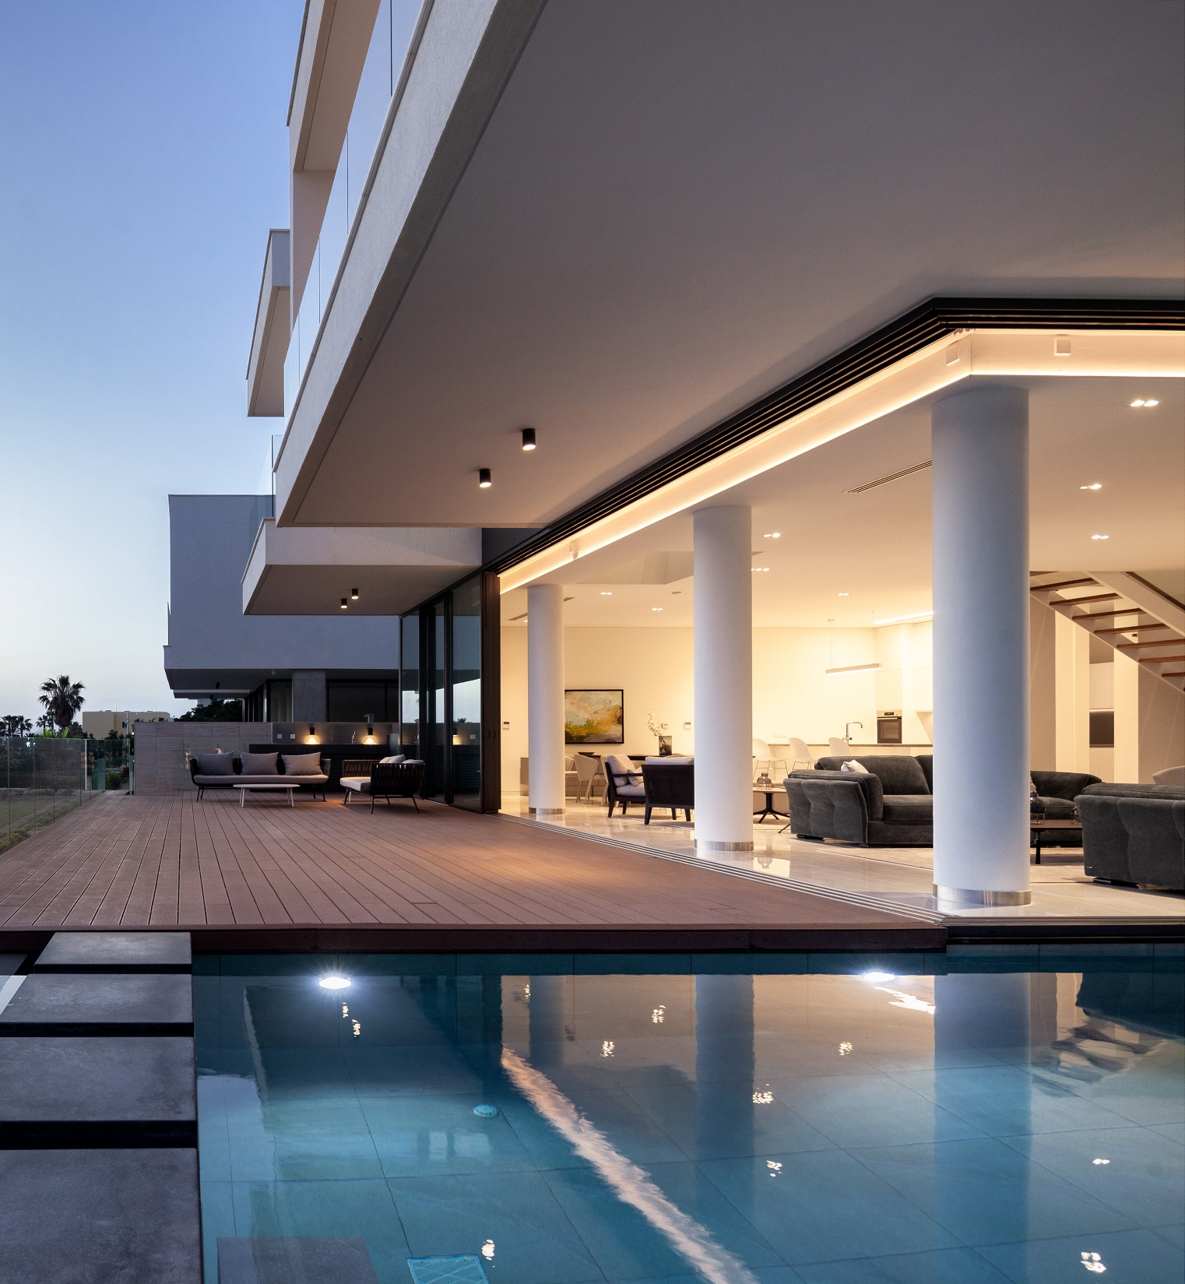
Collaborator
The Developer
Aristo developers is undoubtedly Cyprus’ pioneer Golf developer. As the first company to establish two, Internationally-Renowned golf courses on the island, Aristo Developers continues to design signature golf resorts, boasting unparalleled luxury, destined to become timeless classics.
40+
40+
265+
40+
1500+
YEARS LEADING
THE CYPRUS
PROPERTY MARKET
DEVELOPMENTS
CURRENTLY
IN THE MARKET
COMPLETED
ISLAND -WIDE
DEVELOPMENTS
NATIONALITIES
OF CUSTOMERS
GLOBAL NETWORK
OF ASSOCIATES

Slide 26
Collaborator
The Developer
ARISTO DEVELOPERS IS UNDOUBTEDLY CYPRUS’ PIONEER GOLF DEVELOPER
As a reputable property developer, Aristo Developers has been recognised for its high-level, quality product by a plethora of local and international organisations. Having been acknowledged by the International Finance Magazine as “Best Real Estate Cyprus Developer” in 2016 and 2019 for innovation and performance, and receiving the accolade for “Best Cyprus Property 2017” by the European Property Awards, Aristo Developers was also the first CLASS A property and construction developer in Cyprus to be endorsed by the International Standards Organisation (ISO 9001) for quality.

Slide 27
Landmarks
The Developer
Our successful performance is supported by an extensive client base, and our ability to guarantee delivery dates and title deeds. With over 265+ island wide developments, and 40+ new projects currently in the market, Aristo Developers is also the pioneering force behind large-scale investments, such as the Venus Rock Golf Resort, Kings Avenue Mall and The International School of Paphos.

Slide 28
Collaborators
EDSA (USA)
for the general masterplan and land utilisation
Petros Stamatris Architects (Cyprus) for the leisure, commercial and
residential elements
Graham Marsh Golf Design (Australia) & Golf and Land Design (Austria) for
the 18-hole championship Golf Course
index

Slide 29
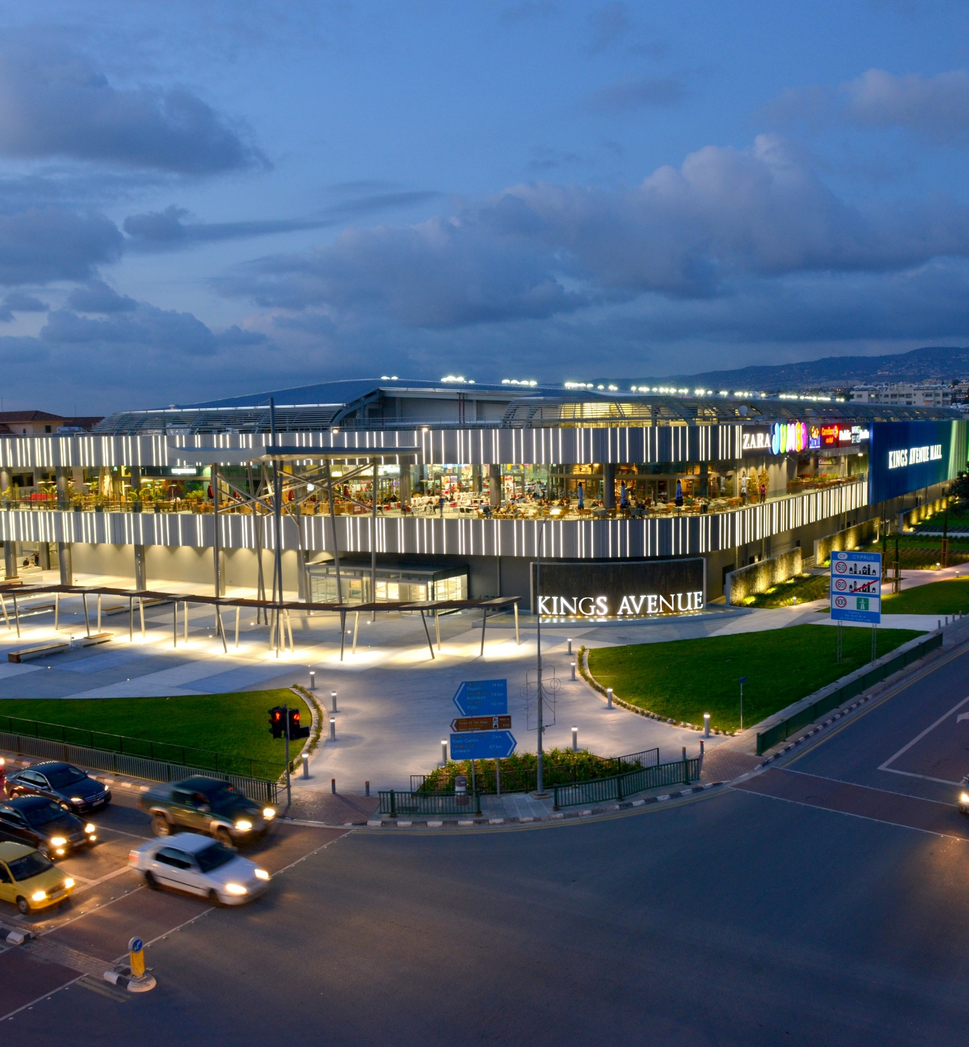
Landmarks
Aristo Developers
The Kings Avenue Mall is an impressive full-concept shopping mall located in the heart of central Pafos. Offering its visitors the ultimate shopping experience, the mall is anchored by a vast selection of entertainment facilities and department stores of leading international fashion brands and retailers. Developed by Aristo Developers, its total investment exceeded the amount of €170 million.

Slide 30
Landmarks
Aristo Developers
Aimed at becoming Europe’s largest golf-integrated beachfront resort with world-class facilities and services, the Venus Rock Golf Resort is home to the Secret Valley Golf Club designed by four time Ryder Cup Captain and winner of the British and US Open, Tony Jacklin. Upon completion, the resort will feature 3,400 luxury residential units with an estimated sales value of €5bln.

Slide 31
Landmarks
Aristo Developers
Established in 1987 by Aristo Developers aiming to provide a high level of educational opportunities for its students, the International School of Paphos offers state-of-the-art facilities and boarding house in a safe, positive and modern environment. The school caters for all stages (Kindergarten, Primary and Secondary), is registered with the Cyprus Ministry of Education and Culture and is affiliated with many international accredited institutions.

Slide 32
EDSA’s global experience pays tribute to the passionate creation of distinctive, innovative, and inspiring environments. Working in conjunction with nature to achieve impressive results with enduring appeal, the renowned landscape architecture company designs outdoor spaces that are timeless, never forced – and establishes relationships that strngthen these concepts for future projects and generations. With an eye towards holistic development, land preservation and aesthetic cognizance, EDSA’s designers improve the relationship between people and place. They graciously accept their role as stewards of the land and the built environment with the full creativity, integrity, and the commitment of their entire worldwide team.
Petros Stamatris Architects (Cyprus)
for the leisure, commercial and
residential elements
Graham Marsh Golf Design (Australia) & Golf and Land Design (Austria) for
the 18-hole championship Golf Course

Slide 33
Petros Stamataris Architects design and imagine every project individually; from the largest scale to the smallest, seeking excellence in every detail. The renowned Cypriot architectural firm strives to create an unbelievable experience, handcrafted and tailored exclusively to the requirements of each distinct client that exceeds their expectations, taking inspiration from the location and the views as an ever-present backdrop. Drawing from his Italian architectural influences, the EAGLE PINE GOLF RESORT conjures images of umber tones, sweeping modern lines that echo a strong, simple, elegant and rustic tone all at once.
EDSA (USA)
for the general masterplan and land utilisation
Graham Marsh Golf Design (Australia) & Golf and Land Design (Austria) for
the 18-hole championship Golf Course

Slide 34
Graham Marsh Golf Design is regarded as one of the world’s leading Golf Course Architects. As a golf course professional, Graham Marsh is the winner of 64 tournaments internationally and successful on all five of the world’s major tours. With over 30 years’ experience, Marsh’s commitment to golf course architecture is exemplified by his personal involvement and professional input to every stage of the golf design process. Together with Graham Marsh Golf Design, Hans-Georg Erhardt’s golf course architecture and landscape has created a natural looking golf course with splendid views, carefully carved into the existing nature, set to provide a challenging test of golf for all calibres of golfers.
EDSA (USA)
for the general masterplan and land utilisation
Petros Stamatris Architects (Cyprus) for the leisure, commercial and
residential elements

Slide 35
Resort
GOLF INTEGRATED
RESIDENTIAL LUXURY RESORT
WITH HOTEL & SPA

Slide 36
Resort

Slide 37
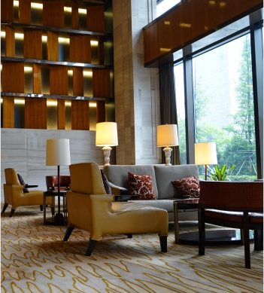
Golf
Golf
SIGNATURE GOLF COURSE
Graham Marsh was called in to design EAGLE PINE’s championship golf course, a stunning 18-hole layout back-dropped by breath-taking mountains, natural terrain, and the alluring waters of the Mediterranean and beyond. Marsh’s layout has been thoughtfully integrated into the environment, with minimal impact on the area’s indigenous fauna and flora. Undulating fairways, challenging greens and strategic bunkers will appeal to both experiences and novice golfers, aimed at creating a golfing experience like no other.

Slide 38
Golf
Golf
The EAGLE PINE GOLF RESORT will house comprehensive practice facilities for those who want to perfect their swing before heading out onto the green. These facilities will include a chipping and bunker practice area and a driving range with both open air and undercover practice bays. Golfing enthusiasts and aspiring professionals will be welcome to attend the onsite Golf Academy and gain access to expert advice and tuition.
Clubhouse
9,500 m²
Golf Course
18-HOLE CHAMPIONSHIP
PAR-71
Pro Shop
FULLY-EQUIPPED WITH
BRANDED APPAREL
Facilities
THEMED RESTAURANT
BAR/CIGAR LOUNGE
LUXURY CHANGING ROOMS

Slide 39
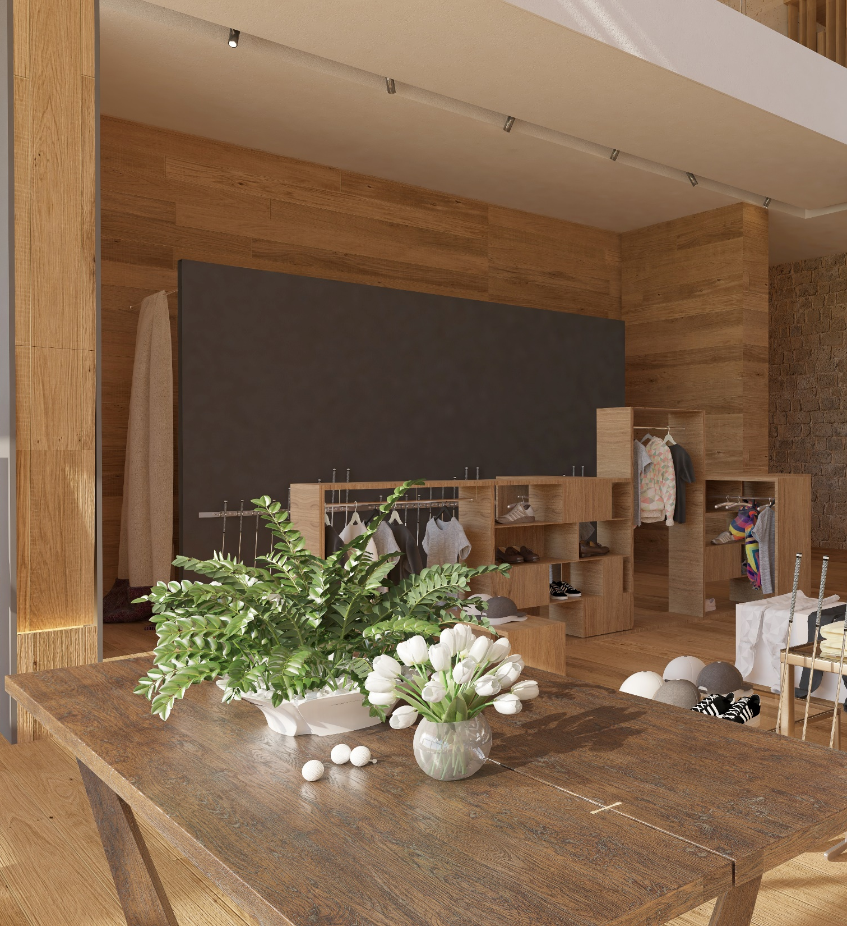
The Club house
Golf
THE CLUBHOUSE
The Clubhouse will be home to an elegant, themed restaurant, bar, luxury change rooms and facilities, and a fully-equipped Pro Shop featuring high-end branded golfing apparel to clubs and accessories. The Clubhouse will offer golfers everything they need to maximise their sporting experience.

Slide 40
Pro Shop
Golf
THE PRO SHOP
The EAGLE PINE GOLF RESORT will house comprehensive practice facilities for those who want to perfect their swing before heading out onto the green. These facilities will include a chipping and bunker practice area and a driving range with both open air and undercover practice bays. Golfing enthusiasts and aspiring professionals will be welcome to attend the onsite Golf Academy and gain access to expert advice and tuition.

Slide 41
The Residences
The Residences
DISTINCTIVE LIVING
EAGLE PINE GOLF RESORT is home to prime residential property that caters to a range of lifestyle needs and preferences. Residents will own a piece of this sought-after location and have access to a plethora of five-star amenities and services. Style and sustainability go hand in hand throughout, from the natural stone and wood used in design to the landscaped gardens that compliment one’s perfect place to call home.

Slide 42
The Residences
The Villas
DISTINCTIVE LIVING
EAGLE PINE GOLF RESORT offers residents a unique variety of lifestyle options to cater for one’s individual living preferences. Tranquillity, security and privacy, all coupled with superlative service, the villas at EAGLE PINE GOLF RESORT are inspired by Mediterranean living and modern architectural design.

Slide 43
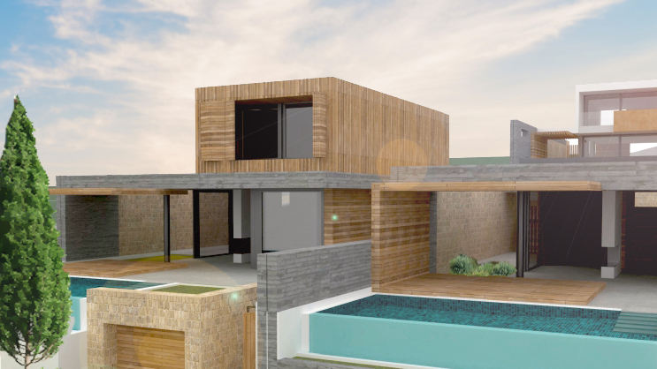
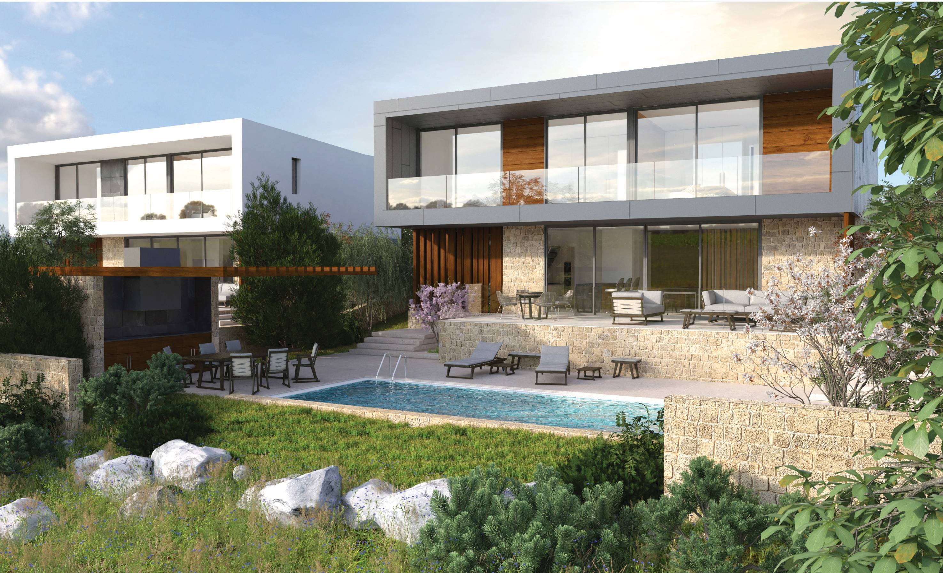
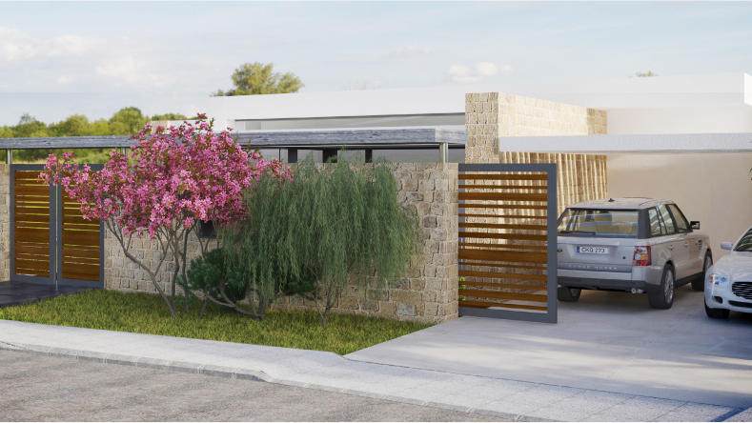
The Residences
DISTINCTIVE LIVING

Slide 44
The Residences
The Villas
Set in a prestigious location, these opulent homes are complimented with private swimming pools, spacious and functional interiors, enhanced by their sensational views.
Luxury Villas
700 VILLAS IN INDIVIDUAL PLOTS
Buildable Cov.Area 147,000 m²
Buildable Land Area 437,000 m²
Architectural Design CONTEMPORARY
MEDITERRANEAN STYLE

Slide 45
The Residences
Unified Developments
DISTINCTIVE LIVING
Every element of these residences has been considered and crafted to exceed the highest expectations. The unified developments at the EAGLE PINE GOLF RESORT radiate contemporary charm in an authentic setting; stately homes with high-end features and exquisitely proportioned interiors. Designed to make the best possible use of natural light, these magnificent properties are elegantly styled to make the most of the resort’s second-to-none facilities and services.

Slide 46
The Residences
DISTINCTIVE LIVING

Slide 47
The Residences
Unified Developments
An effortless lifestyle is assured with high-end, luxury finishes and fixtures, making these private residences a suitable choice for incomparable elegant living.
Unified Developments
300 VILLAS, TOWNHOUSES,
APARTMENTS
Buildable Cov.Area 29,000 m²
Buildable Land Area 89,000 m²
Architectural Design CONTEMPORARY
MEDITERRANEAN STYLE

Slide 48
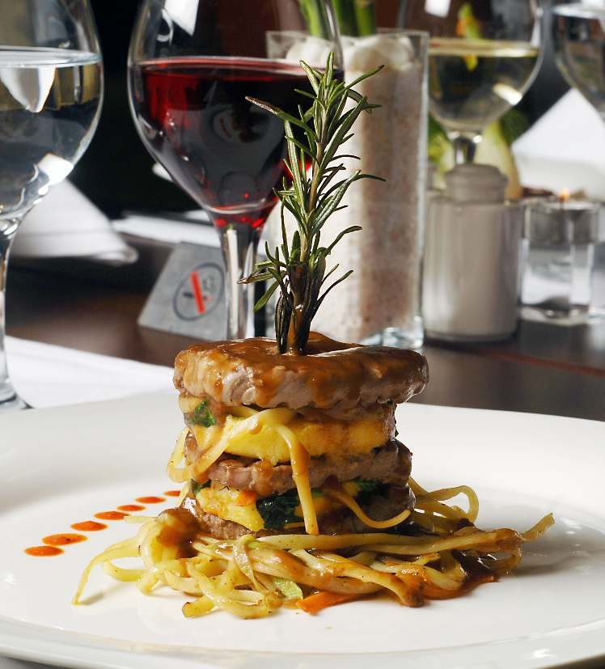
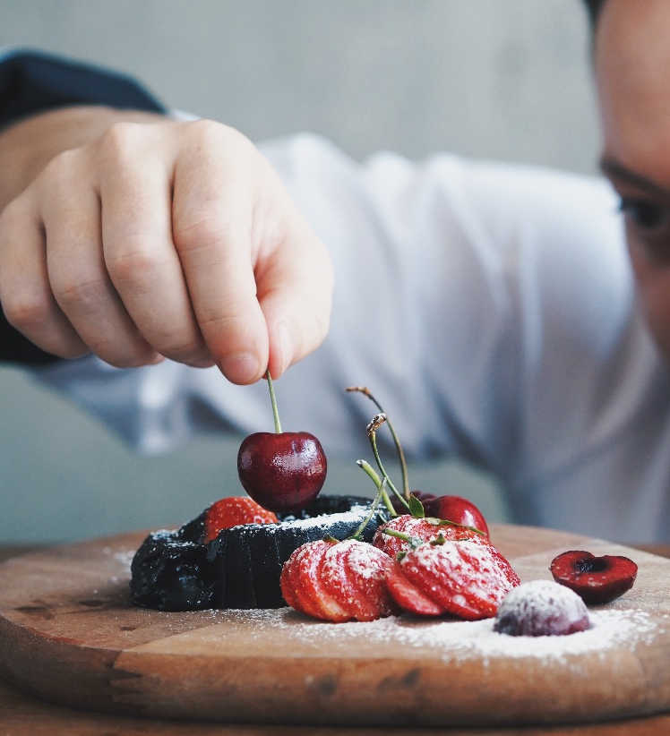
Gastronomy
Dining
UNIQUE RESTAURANTS
The EAGLE PINE GOLF RESORT will offer a range of dining experiences. All restaurants are located in the expansive, centrally located boutique hotel and clubhouse overlooking the manicured grounds. With a diverse selection of food on hand, the resort’s unique restaurants will have something for even the most discerning of tastes; stylishly-presented, Cypriot-fusion cuisine.

Slide 49
Gastronomy
Dining
UNIQUE RESTAURANTS
Warm hues and the finest architectural trimmings have been used to create an ambiance that is inviting, while soft, luxurious upholstered furnishings will inspire a welcoming Cypriot feel.

Slide 50
